Slide 1
Opinion Mining
Bijal Prajapati (26521)
Shahin Rashidbayli (26593)

Slide 2
Agenda
Users opinion
What is OM
Why we need?
Difference between SA
Advantage and Limitations
Practical Work

Slide 3

What everyone think?
What people think is one piece of information..
Which laptop should I buy?
Which Mobile Phone should I buy?
Whom should I vote?

Slide 4


Whom you can ask?
Friends and relatives
Consumer report
Blogs
Google review
E-commerce sites (eBay, Amazon, Flipkart)

Slide 5

Is this true?
Now you have more than thousand information on one topic…
Is it easy for you to study it and make opinion and decision??

Slide 6
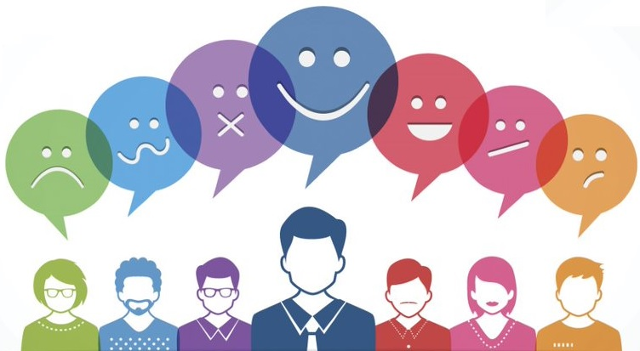
What is Opinion Mining?
Opinion mining is the computational think about people's suppositions, evaluations, and feelings toward substances, people, issues, occasions, points, and traits.
Notes:
A wealth of unstructured opinion data exists online – data that was, until now, unusable. Such data, moreover, is growing all the time. We add to it daily when we talk about our likes and dislikes on social media and elsewhere on the web. We do so in an honest and unsolicited manner, expressing our true feelings towards a brand, a politician, or a global event. The challenge of analysing these data points on a massive scale has created a new science – that of opinion mining.

Slide 7

Why we need Opinion Mining?
Opinion mining is vital for both people and companies. People may need to see the conclusion of other clients around an item to analyze it sometimes buying it.
Companies need to analyze the criticism of clients approximately their items to create future choices.
Analyzing customer"s supposition and their reaction is essential.
Notes:
Mining is used on product reviews that are available on different blogs, web forums, and product review sites to evaluate the opinions of customers. By doing so, new customers are able to find views of others about a product and can decide which product to buy with the help of the opinion of customers already using the product. In addition comparison of the same feature of products by different vendors is done. In this way, companies can focus on improving the features of their products that are not popular among customers. This leads to overcome the requirements of marketing intelligence and product benchmarking in the production industry.

Slide 8
Sentimental Analysis & Opinion Mining
The difference is quite little, and each contains some elements of the other.
Though "sentiment analysis" a forerunner to the field of supposition mining analyze how individuals feel almost a given subject (be it positive or negative), "opinion mining" goes a level more profound, to understand the drivers behind why people feel.
Notes:
Sentiment analysis and opinion mining is almost same thing however there is a minor difference between them that is opinion mining extracts and analyze people's opinion about an entity while Sentiment analysis search for the sentiment words/expression in a text and then analyze it.

Slide 9

Advantage and Limitations
Advantages
The emotions and attitudes behind the words
Save time - identify any negative sentiments being expressed quickly
Help businesses understand the conversations and discussions taking place about them, and helps them react and take action accordingly
Limitations
Computer programs have problems recognizing things like sarcasm and irony, negations, jokes, and exaggerations
Short sentences and pieces of text

Slide 10
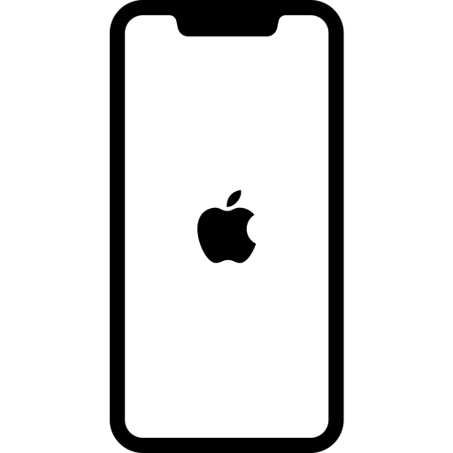
Practical work
What we did?
Fetch tweets from Twitter related to iphone 11 and analyze opinion of the user about positive and negative sides of iphone 11
What we used ?
Python, tweepy, textblob, matplotlib
Github : https://github.com/reshidshahin/OM

Slide 11
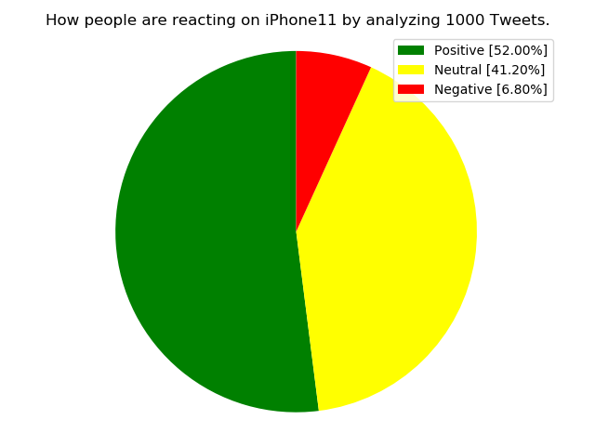
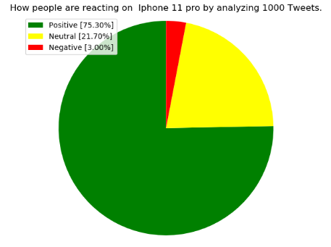
Result
Iphone 11
Iphone 11 pro

Slide 12
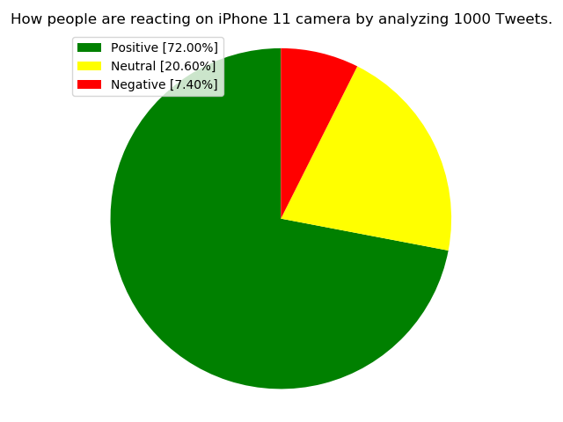
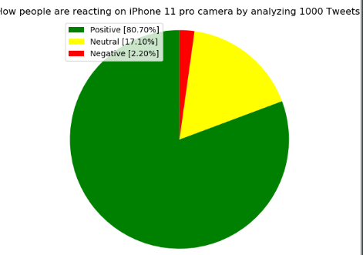
Result
iPhone 11 camera
iPhone 11 pro camera

Slide 13
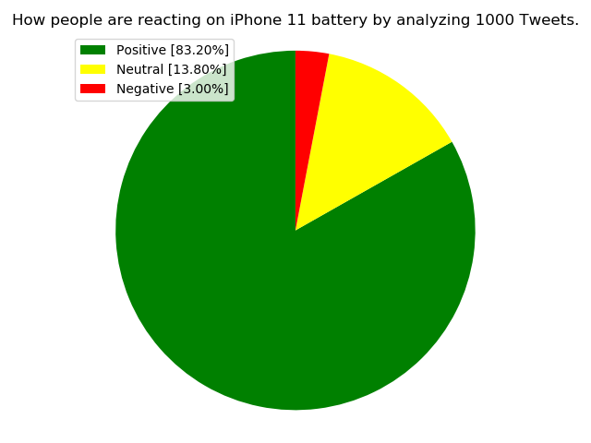
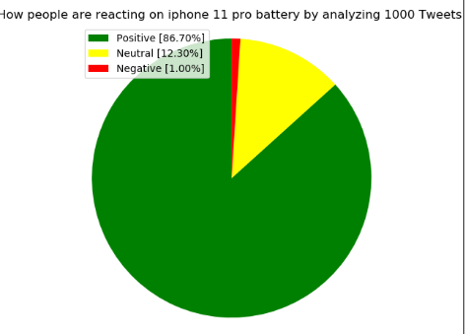
Result
iPhone 11 battery
iPhone 11 pro battery

Slide 14
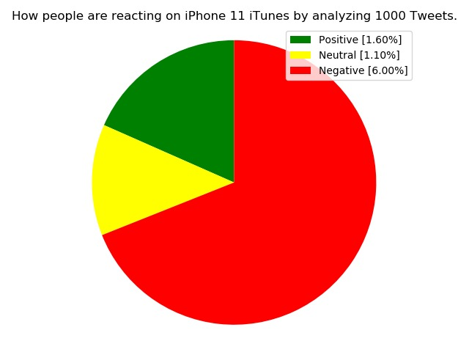
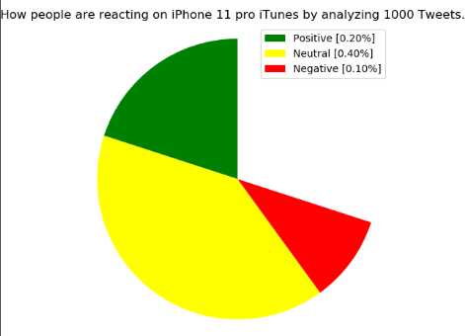
Result
iPhone 11 iTunes
iPhone 11 pro iTunes

Slide 15
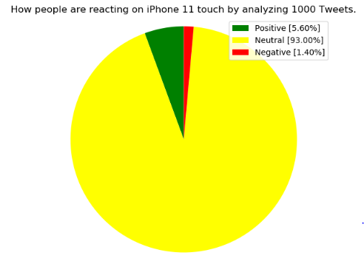
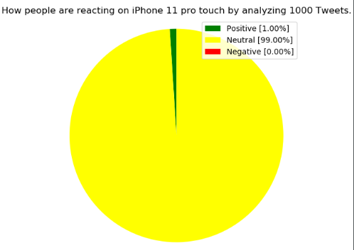
Result
iPhone 11 touch
iPhone 11 pro touch

Slide 16
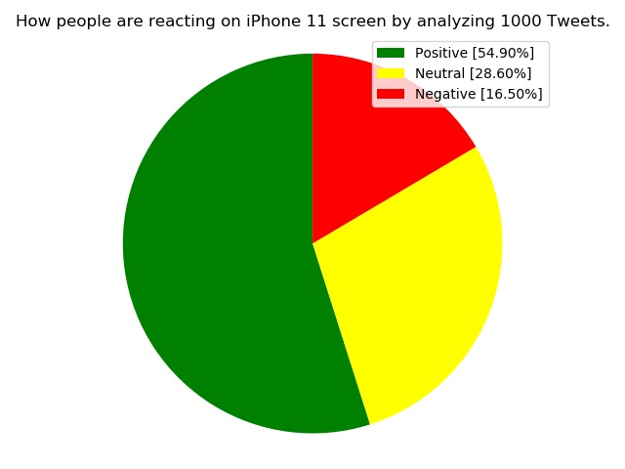
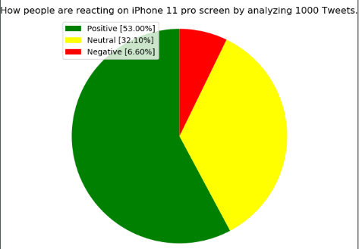
Result
iPhone 11 Screen
iPhone 11 pro Screen

Slide 17
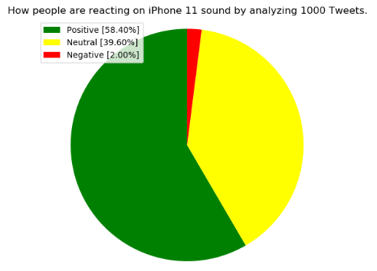
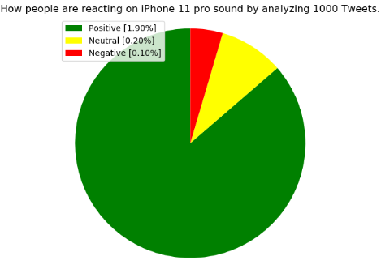
Result
iPhone 11 sound
iPhone 11 pro sound

Slide 18
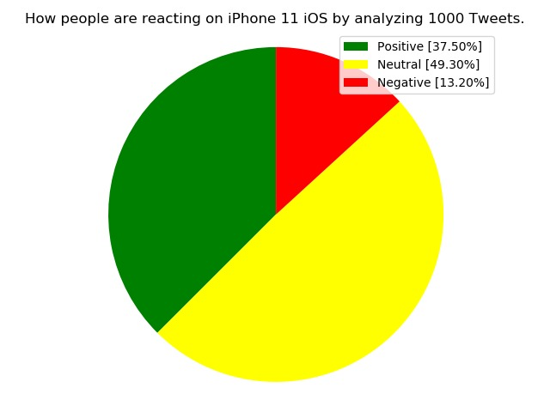
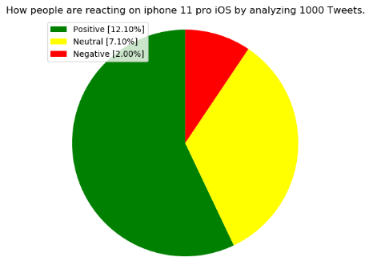
Result
iPhone 11 iOS
iPhone 11 pro iOS

Slide 19
Thanks for your attention :)

